Slide 1


Capstone Project Phase A – 61998
MedCall Supervisor: Mr. Alex Keselman
Team: Tareez Ghandour & Leen Hawa

Slide 2

Introduction
1
The Problem
2
The Solution
3
UML Diagrams
4
Test Plan
5

Slide 3


Introduction
Emergency medical services (EMS) are essential for any community.
Current systems face significant challenges that lead to delays in help’s arrival.

Slide 4

Introduction
1
The Problem
2
The Solution
3
UML Diagrams
4
Test Plan
5

Slide 5






The Problem
Traffic
Delayed data
Communication
Poor phone service
Language barriers
Stressed callers

Slide 6

Introduction
1
The Problem
2
The Solution
3
UML Diagrams
4
Test Plan
5

Slide 7

Our Solution
User-Friendly Platform
Nearest Neighbor Algorithm
Live Tracking
Easy access for all users
Quickly finds the nearest ambulance
Users track ambulance location in real time

Slide 8
Our Solution
Real-Time Communication
Alert System
Optimized Response
Better understanding between users and ambulance driver
Immediate notifications for users, drivers and dispatch centers
Faster and more efficient EMS response

Slide 9



Our Stakeholders
Stakeholders
Individuals
Dispatch Centers
Ambulance Drivers

Slide 10
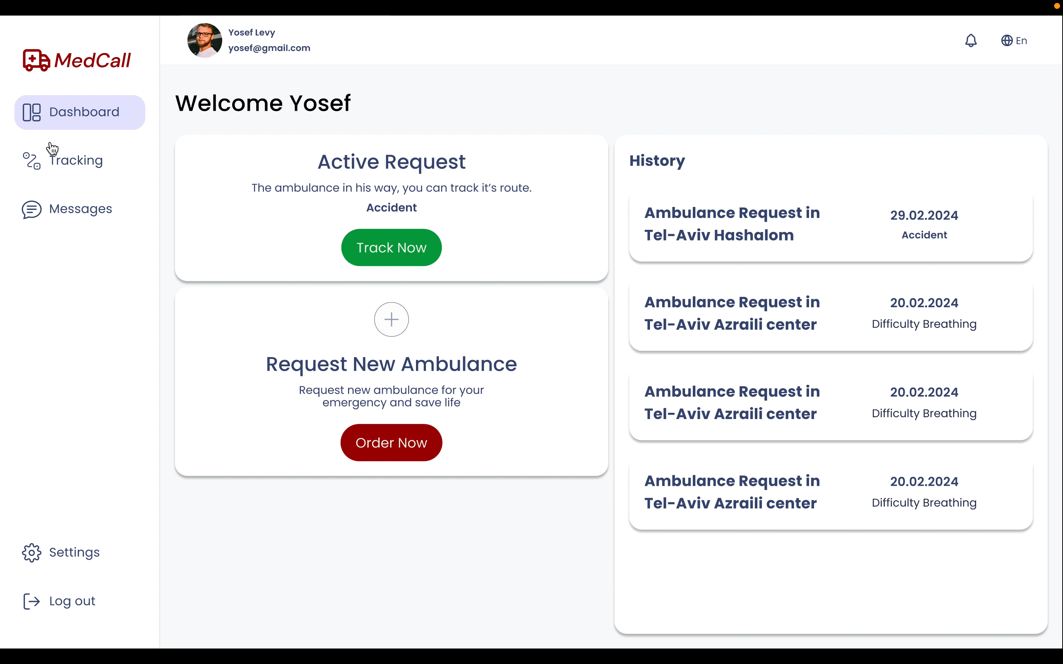
Simulation

Slide 11

Introduction
1
The Problem
2
The Solution
3
UML Diagrams
4
Test Plan
5

Slide 12
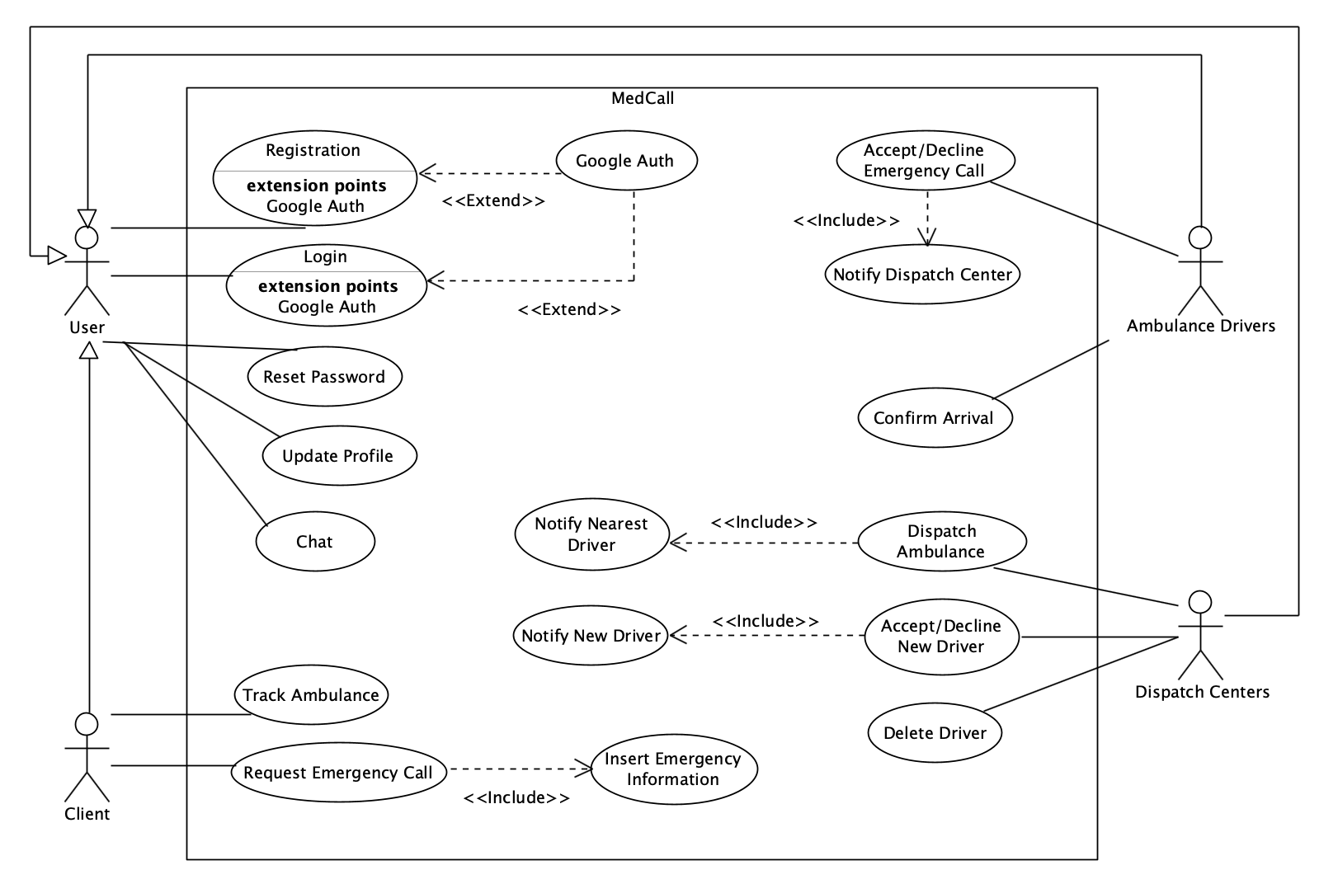
Use-Case

Slide 13
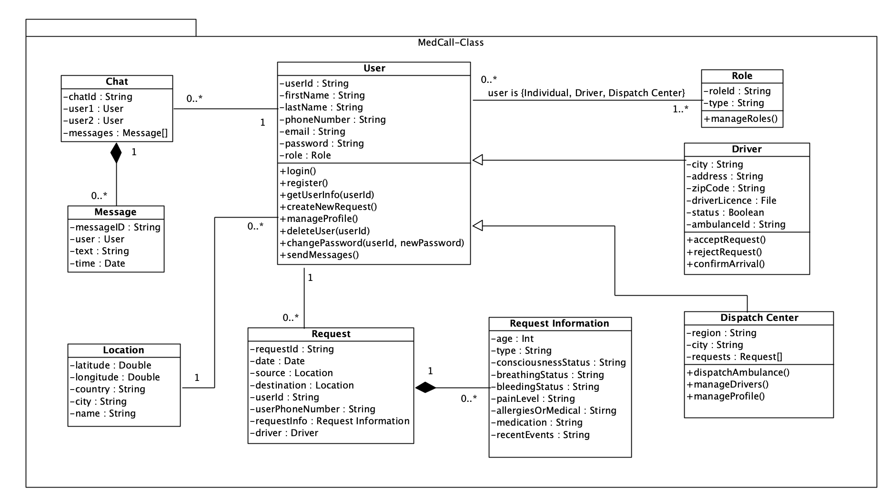
Class Diagram

Slide 14
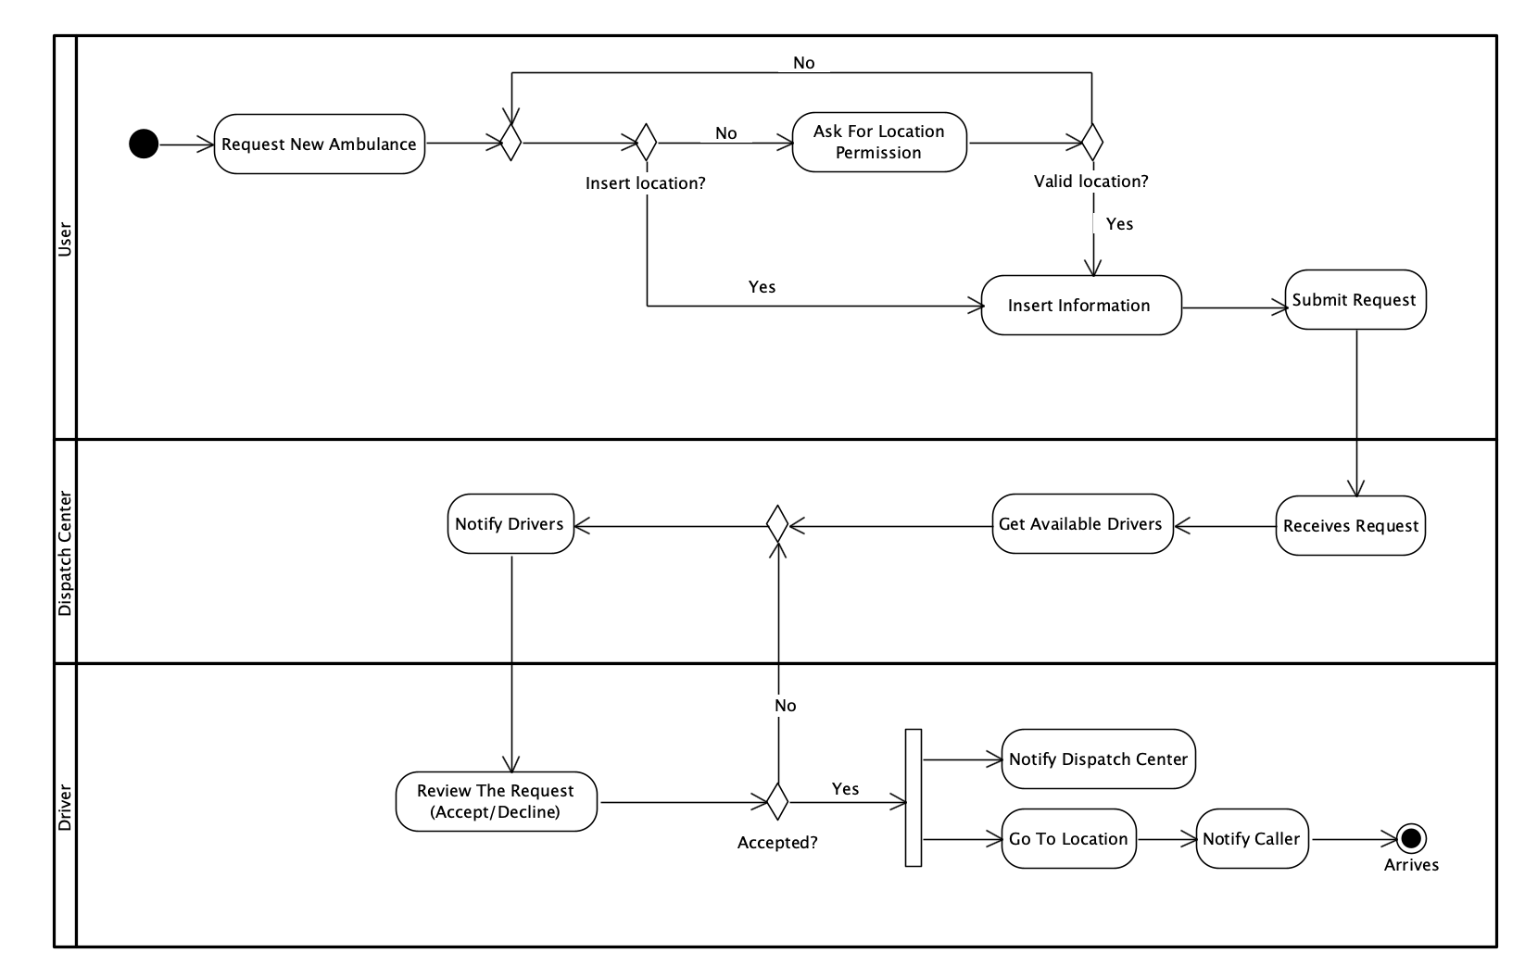
Activity Diagram

Slide 15

Introduction
1
The Problem
2
The Solution
3
UML Diagrams
4
Test Plan
5

Slide 16
Tests Plan For Registration
Test N. | Test Description | Expected Result
1 | Attempt to register a new user with valid input data | The user registration should be successful, and the user should receive a confirmation message indicating successful registration.
2 | Attempt to register a new user with and empty input | The registration process should fail, and the user should receive an error message “Please fill in all the fields.”
3 | Attempt to register a new user with an invalid email format (e.g. missing ”@”) | The registration process should fail, and the user should receive an error message “Please enter a valid email.”
4 | Attempt to register a new user with a weak password | The registration process should fail, and the user should receive an error message “Password must be at least 8 characters with uppercase, lowercase, and number.”
5 | Attempt to register a new user with an email address that is already registered in the system. | The registration process should fail, and the user should receive an error message “Email already in use. Please choose another.”

Slide 17
Tests Plan For Login Process
Test N. | Test Description | Expected Result
6 | Attempt to login with valid credentials | The login process should be successful, and the user should be redirected to their account dashboard.
7 | Attempt to log in with an empty input | The login process should fail, and the user should receive an error message “Please fill in all the fields.”
8 | Attempt to log in with an invalid credentials | The login process should fail, and the user should receive an error message “Email or password is wrong. Please try again!”
9 | Attempt to log in with an email address that is not registered in the system. | The login process should fail, and the user should receive an error message “Email not found. Please signup first.”

Slide 18
Tests Plan For New Request
Test N. | Test Description | Expected Result
10 | Attempt to request a new ambulance with valid information. | The request should be successfully submitted, and the nearest available ambulance should be dispatched to the specified location.
11 | Attempt to request a new ambulance without providing a location. | The request should fail, and the user should receive an error message “Must enter a location.”
12 | Attempt to accept an ambulance request without providing all necessary information. | The request should fail, and the user should receive an error message “Please fill in all the fields.”

Slide 19
Tests Plan For New Request
Test N. | Test Description | Expected Result
13 | Verify that the user receives a confirmation message after successfully requesting a new ambulance. | The user should receive a confirmation message confirming that their request has been received.
14 | Verify that the user can track the real-time location of the dispatched ambulance. | The user should be able to track the ambulance's location in real-time on the platform's map interface.
15 | Test the communication channels between the user and emergency services during the ambulance request process. | The user should be able to communicate with emergency dispatchers through chat to provide additional information or updates during the emergency.

Slide 20
Tests Plan For Accept/Decline/Edit Drivers
Test N. | Test Description | Expected Result
16 | Attempt to accept a driver request with valid information. | The request should be successfully accepted, and the driver should receive a confirmation message.
17 | Attempt to accept a driver request with an invalid information | The acceptance process should fail, and the driver should receive an error message "Invalid request. Please provide all necessary information."
18 | Attempt to decline a driver request with valid information. | The request should be successfully declined, and the driver should receive a confirmation message.
19 | Attempt to edit driver information with valid input data. | The driver information should be successfully updated, and the driver should receive a confirmation message.
20 | Attempt to edit driver information with missing necessary information. | The update process should fail, and the dispatch center should receive an error message "Please fill in all the required fields."

Slide 21



